Slide 1
Abstract Data Types
An organization of data and methods whose underlying data representations are hidden from the client
ADTs Support
Organization of data
Methods to perform operations on the representations
“Hidden from client”
A well-defined interface can be used to define how a client piece of software would interact with the abstract data type
We call these interface definitions, Application Programmer Interfaces or APIs
Notes:
This video reviews abstract data types in Java. Recall that these objects support the organization of data and provide methods to operate upon the data representations. They also hide the details of the data structure from the client and only expose a well defined interface, which is defined via an API.

Slide 2
Object Oriented Programming
Object-oriented programming is not required for implementing the data structures within this course but utilizing structured objects such as classes in Java or C++ (or structs in C/C++).
An object has: Identify, State, and Behavior.
A class is a template for object creation (i.e. specification of attributes and operations.
Java packages group together related classes.
e.g. built-in packages import java.util.Date
java.util is a collection of utility objects built into Java
We can define our own collection of object, i.e. our own packages
package edu.erau.cs315;
Notes:
In Java, we use object-oriented programming concepts to define objects, which store the identify of the data being represented, its state, and the behavior the ADT can have upon the model. The class defines the specification of the object.
You write the class in Java syntax to define the object. When you use new, your program creates an instance of the object out on the memory heap and returns a reference to that object for your program to use.

Slide 3
Java Object Basics
All objects inherit these methods. Subclasses can override methods to produce class-specific
Notes:
Each java object has several basics. getClass provides an identify, toString() provides a means of passing an object to .print or.println and having it automatically call toString to receive a string representation. Equals is used for comparison of two objects. Finally, hasCode will return a numeric representation of the object using a hashing function which will serve as an identifier for some algorithms (more on those when we get to hash tables).

Slide 4
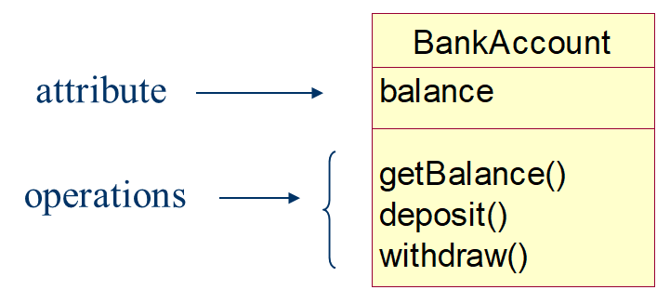

Defining ADT as Java Class
Three labels for accessibility for methods and variables
Public
Accessible by any other object
Protected
Accessible only to derived classes (i.e. subclasses)
Private
Accessible only to instances of this class
Default
If non-specified, then accessible by all classes in package
Static variables and methods exist in one instance even if no object of the class exists (class variables or methods)
e.g.
static double interestRate;
static double calculateInterest(double amount, double duration) {…}
Non-static variables and methods are associated with instances of the class (instance variables)
e.g. balance, getBalance(), etc
Notes:
As I said earlier, we define our Java class as a set of attributes and operations defining the identify, behavior, and state.
We can think of them as black boxes.
We use keywords such as public, protected, and private to control the level of access outside clients can have on the underlying structure of the data. For instance, methods that are private can only be accessed by instances of the class. The default is public for all classes within the package if you have defined a package for your class.
We use keywords static on attributes to define variables that will share the same value and memory address across all instances and do not actually require an instance of the class to exist. Static methods do not require an instance of the class for the method to be called. Many helper functions such as those in the math class are examples , e.g. Math.sin(0.32); would not need a “Math” object to call the static method sin to generate the sine value.
Non-static are tied to the object instances. Static objects are tied to the class definition only.

Slide 5
Public, Private, Protected Table
http://java.sun.com/docs/books/tutorial/java/javaOO/accesscontrol.html
Notes:
This figure is helpful for explaining the level of access available given protections. It is assuming that you are thinking about the level of access from other classes to an instance of the Alpha object in Package One.
We can see how thee modifiers influence whom can access Alpha’s class variables or call Alpha’s class methods that are not static.
I often default to private for all data structure elements that do not need to or ought not be accessed by an outside client. I use protected if I anticipate that I will be extending the class and/or needing to directly interact with an object instance’s variables.
I recommend looking at the examples in the book and online. You will start to see some patterns on what we declare public vs. protected vs. private.

Slide 6
Practice 1
package edu.erau.CS315;
public class A {
private int varA
public void getVarA() { return varA; }
}
Would the following be valid?
package edu.erau.CS315;
public class B extends A {
public int varB
public void getVarA() { return varA; }
}

Slide 7
Practice 2
package edu.erau.CS315;
public class A {
protected int varA
public void getVarA() { return varA; }
}
Would the following be valid?
package edu.erau.CS317;
public class C {
public void getVarA(A anA) { return anA.varA }
}

Slide 8
Class and Clients
Counter API
Constructor:
Counter(String ID)
API Methods:
void increment()
int tally()
String toString()
Notes:
Consider the following implementation of an API.
The counter API would have several well defined methods where we know the input, output, and expected behavior, but we treat the details of the behavior as unknowns. Or, black boxes. Given only the API, you could implement the main on the left putting your trust that the implementer of the methods do them correctly. This allows you to share your data structures and algorithms to be used by others without them having to know how your code works. They must only agree to the API, which serves as a “contract” between developers.
i.e. the contract says that this is what the class should do and how you should interact with it, and the implementer builds the class to implement those methods and deliver those desired capabilities.
Rather than go through the details here. Take a moment on your own to review this example. Feel free to pause the video or reference it in your textbook. Observe which elements are private, which should not be accessed directly by an outside client, and which are public. Note how the API elements are declared as public so that the outside client can make calls to them on instances of the counter.

Slide 9
Example
Your client does not have to be the main of the implementing .java file
Consider this example where a separate class file is produced to create a client called Flips, which uses the counter
Flips designer does not need to know how Counter stores its name or the count.
Only that it has means of creating the counter, incrementing its value, retrieving the tally, and printing the counter’s current state.
Notes:
Your client does not have to be in the same.java file. This is helpful as you can separate out your testing logic or your utilization logic from your implementation. In data structures, we often implement them as reusable tools that we can apply to different problems.
In the example here. The flip designer is again using the contract of the API to guide their implementation. It utilizes the counter to do some measures of simulated random coin flips and tracks the counts for heads and tails using th eincrement method and the tally method to determine the delta or difference.

Slide 10
Inheritance
BankAccount
An object-oriented technique in which a derived class (sub-class) inherits attributes and methods from a parent or super class
In subclass, non-final methods may be overridden
balance
owner
fee
getBalance()
getFee()
getOwner()
getReport()
deposit()
withdraw()
JointAccount
FreeChecking
jointOwner
minBalance
getJointOwner()
getMinBalance()
getReport()
getReport()
Notes:
Inheritance is another important concept. You can derive child classes that inherit the methods and attribuets of the parent class and can override non-final elements.
We can the parent class the super class.
In the example, a bank account could have two subclasses with greater specialization for specific accounts. JointAccount adds an additional owner and overrides the getReport to include that owner. FreeChecking has a minimum balance attribute and overrides the getReport() method to show min balance.

Slide 11
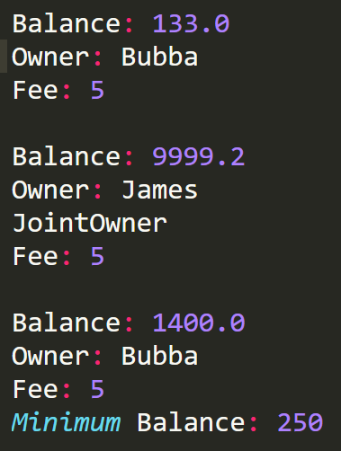
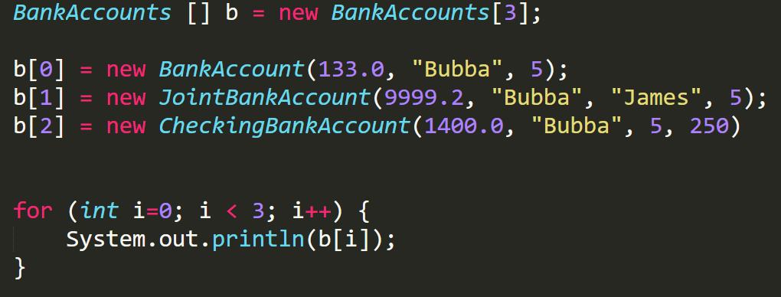
Polymorphism
Polymorphism – in OO terms, an entity (method or variable) may have a different meaning given which object is used.
Dynamic binding – the connection to the called entity is not established until runtime.
Static binding is done at compile time
Assume each account type has its own two string.
Notes:
Polymorphis or “many forms” is important because in Java we have the capability of using Dynamic binding. This permits us from creating a data structure that stores data of a particular type defined by some super class and it can also store the subclass types as well. It simply will dynamically bind to the appropriate class definition matching how the parent’s instance variables and methods are accessed. You can always manually cast it to the child class if you need access to its methods.
For instance, in the previous example,

Slide 12
Java References
Recall the following:
Non-primitive type Java variables store the reference (i.e. memory reference) to the location where the object is stored in memory.
Java handles memory allocation for you.
What would happen in the following example?
class Node {
String name;
int age;
public Node(int name, int age)
{
this.name = name;
this.age = age;
}
}
Node p = new Node(“Bob”, 25);
Node q = new Node(“Bob”, 25);
System.out.println(p == q);
Notes:
Now, we need to talk a bit about Java and memory. The textbook goes into more details, but here is the basics.
First, if you are working with a primitive data type, the variable storing it is storing its values.
Otherwise, if it is based upon an object, including Array’s, which are a type of object in Java, you are actually storing the address to the object in memory. This can create all kinds of fun. We will first show this example and then do another one.
First, let’s create a class called Node. This Node object stores name and age.
In the code using it below we see p and q creating two Nodes with the same values. However, they are not equal. Why?
Well, the variables p and q are only storing the references. Each time we call new, we create a new object on the heap. That object has a memory address which is returned and stored in our variable. So, p == q is comparing memory addresses and not the actual values.
If we wish to implement a way of comparing values, we must implement a class method “equals.” We will see examples of object-based comparisons using .equals and .compareTo later in this course.
Now, let’s see another example that illustrates memory.

Slide 13
Example of memory and objects:
a
633
b
811
b = a = 633
633
12
31
1999
811
1
1
orphaned
2011
Notes:
In this slide, we see two date objects created using the Datable interface, a and b. Both implement new instances on the heap of Date and return the references. However, if we set b=a, we override the memory address stored in b to be the same memory address stored in b.
In the figure on the left, we can see the final result. Variables a and b both reference the date object for 12/31/1999.
The other date object is orphaned. When an object is orphaned, no variables reference the object and it cannot be accessed.
Java tracks references to each variable within the program. Once the reference count reaches zero, the object is no longer accessed and effectively deleted. Java then frees the memory using the garbage collector. In C/C++, you would need to free the memory that is no longer needed manually otherwise you would produce a memory leak, i.e. memory is used but not freed causing you to slowly run out of consumable memory.

Slide 14
Java References continued
What would happen in the following example?
Node a = new Node(“John”, 30);
Node b = a;
a.name = “Jeff”;
a.age = “22
System.out.println(a.name + “\t” + a.age);
System.out.println(b.name + “\t” + b.age);
A clone operation would be needed to do a deep copy of the underlying object stored at b.
class Node implements Cloneable{
String name;
int age;
public Node(int name, int age) {
this.name = name;
this.age = age;
}
public Object clone() {
return new Node(name, age);
}
}
);
You would have the same name and age printed.
Both a and b are referencing the same object in memory.
Node b = a; copies the reference, but not the values.
Node a = new Node(“John”, 30);
Node b = a.clone();
a.name = “Jeff”;
a.age = “22
System.out.println(a.name + “\t” + a.age);
System.out.println(b.name + “\t” + b.age);
Notes:
One means of handling equality between two objects if you need to make another copy is to create a clone method. In the example, we would see that duplate of a is made. This would allocate additional memory on the heap for the new object and could copy the values. The clone is not the same object. Just an exact copy.
You have to implement Clone by making the class Clonable, which requires implementation of the method public Object Clone. Here see that the clone method returns a copy of the Node object by calling new and passing its class attribute values into the new node’s constructor. This means that b receives the address to the new node object.

Slide 15
Mutability of ADTs
Notes:
This last slide goes through some details on mutability of ADTs. Mutability means the ability to change the underlying data of the object.
I simply found it a table worth noting as it talks about in the right hand side characteristics of using private, public, etc and the implications it has for various types of classes with practical examples that we will encounter within the course.

